Slide 1

Speed Up Comparison - Applying Parallelism in Machine Learning
K-Means Clustering in MPI vs in Spark MLlib
Binwei Xu & Brandon Liang

Slide 2
Big Data and Machine Learning
Big Data: Volume, Velocity, Complexity
Machine learning: a method of data analysis that automates analytical model building.
Algorithms iteratively learn from data, allowing computers to find hidden insights without being explicitly programmed where to look.

Slide 3
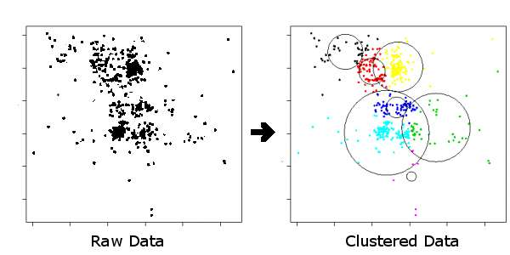
Challenge: Runtime
Big Data: Volume and Complexity
Machine Learning: Iterative Computation
n iterations

Slide 4
Concurrency or Parallelism?
Concurrent:
Computation Executed in Parallel instead of Sequentially
Parallel:
Distribution of Data
Use Parallelism for SPEEDUP

Slide 5
Parallelism Alternatives
MPI - Message Passing Interface
Distributed Memory
Multi-Machine Processes
Communication via Collective Operation
Apache Spark
Resilient Distributed Dataset
In-Memory Computation on Clusters (Upgrade over MapReduce)
Transformation & Action (Reduce & Aggregation)
Fault Tolerant

Slide 6
Context of Problem
NBA Play-By-Play Data
Volume:
12 Seasons, 30 Teams, 1230 Games, 400+Positions
Focus:
Margin Range -> Position Count
Goal:
Classify Each Team by Cluster using Unsupervised Clustering on Margin-Position% Break Down

Slide 7
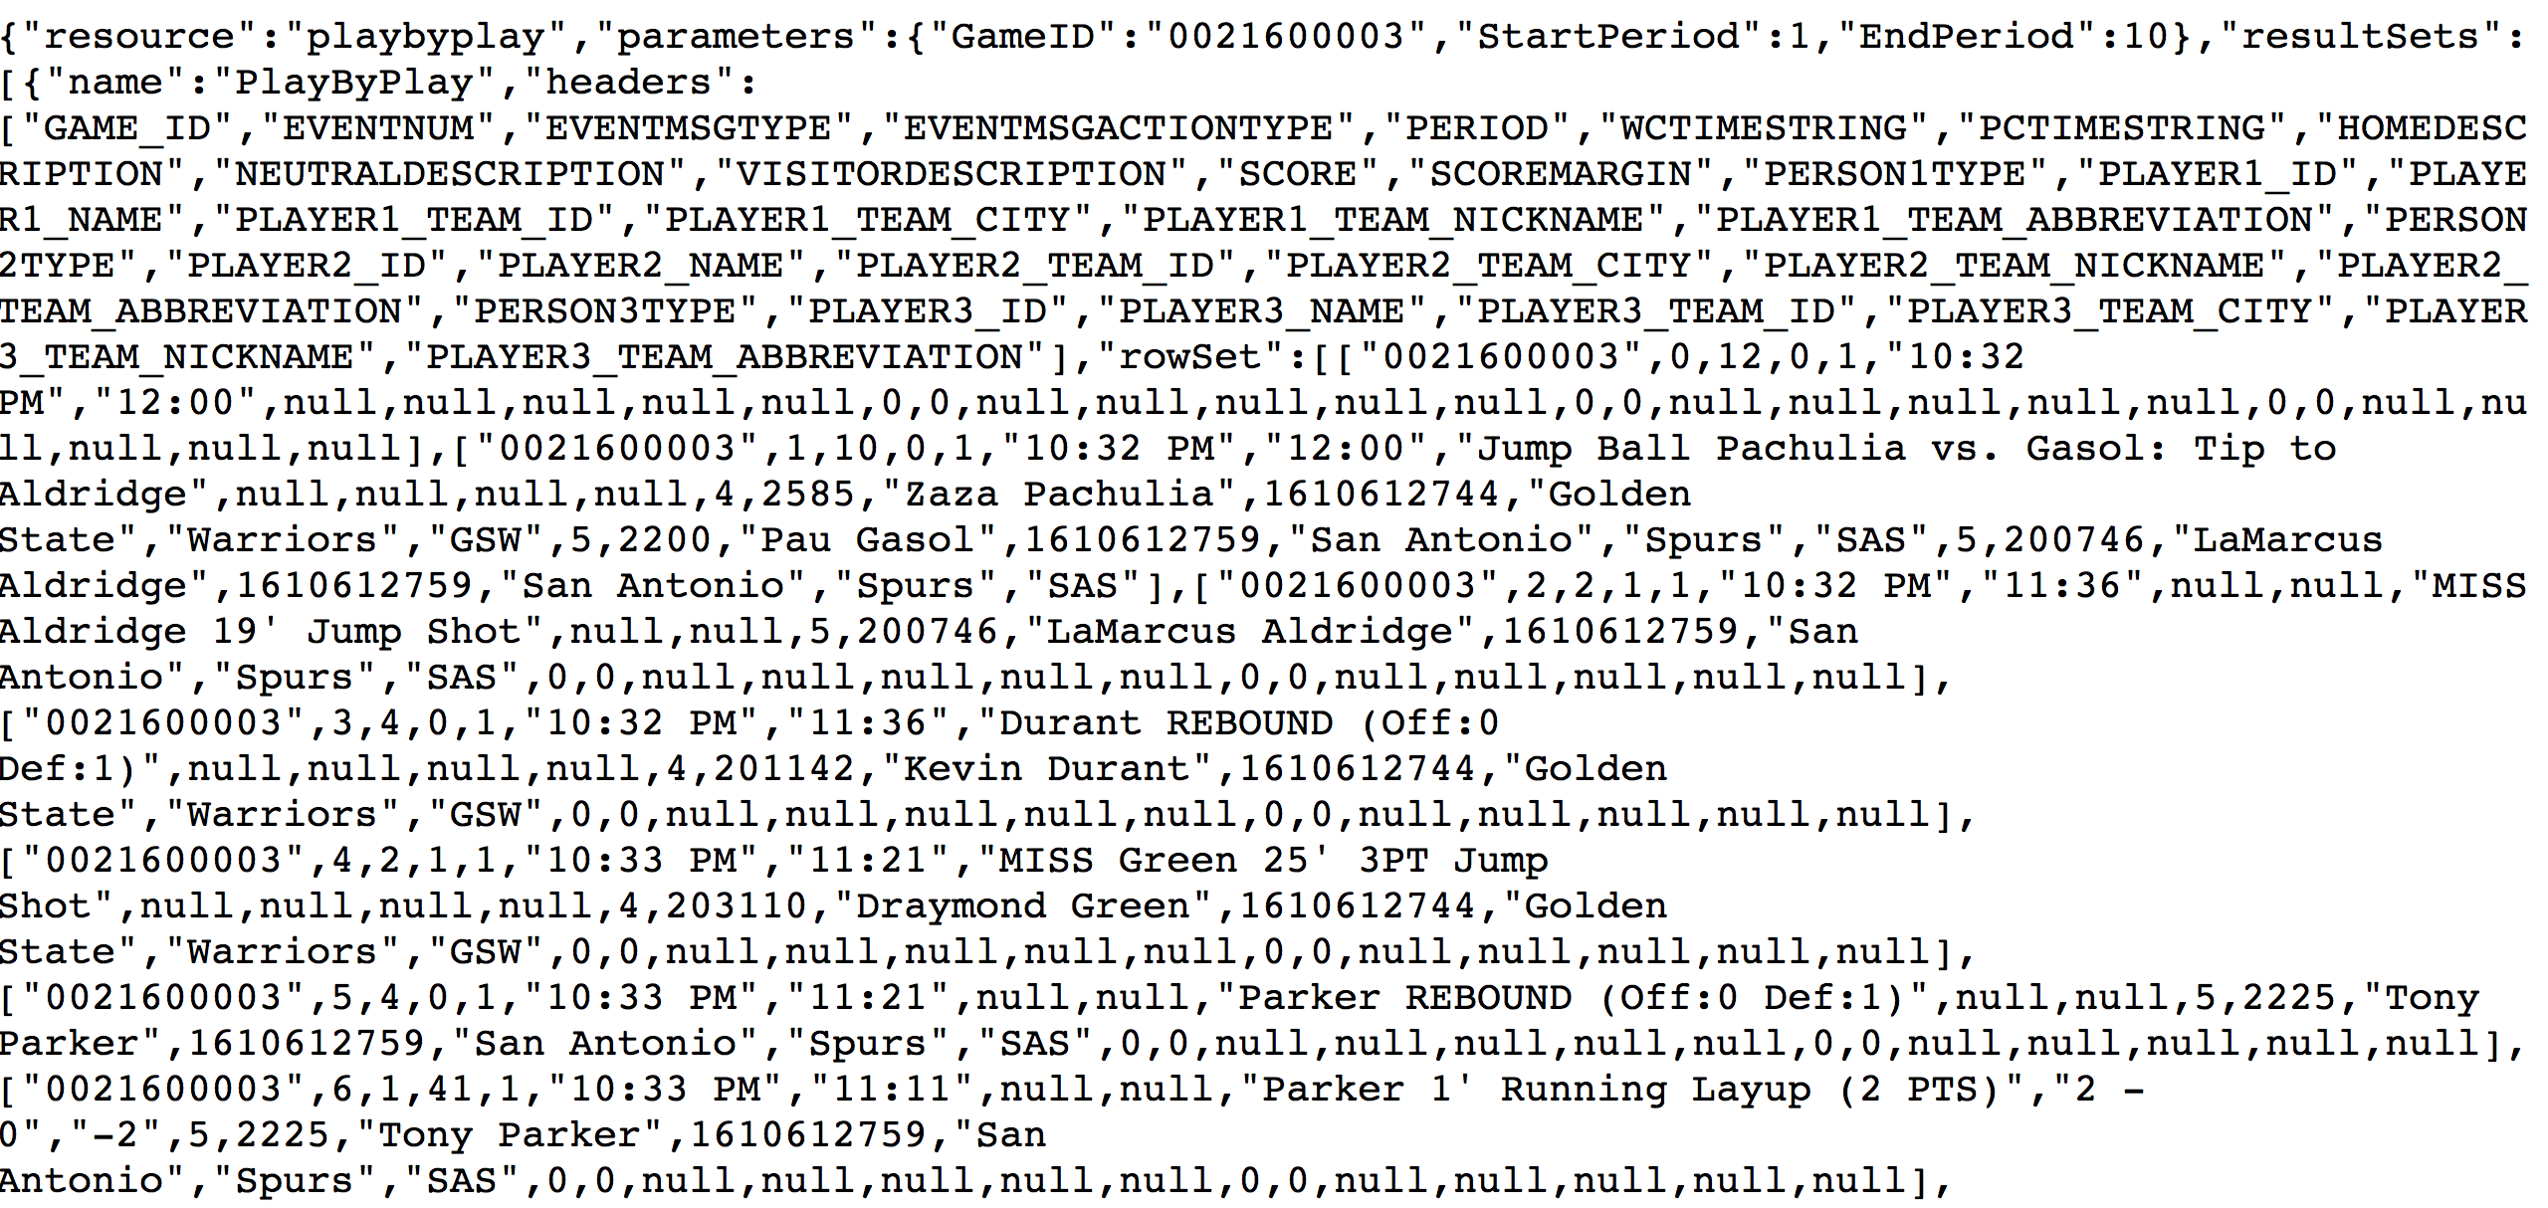
Original Data
NBA Play-By-Play Data

Slide 8
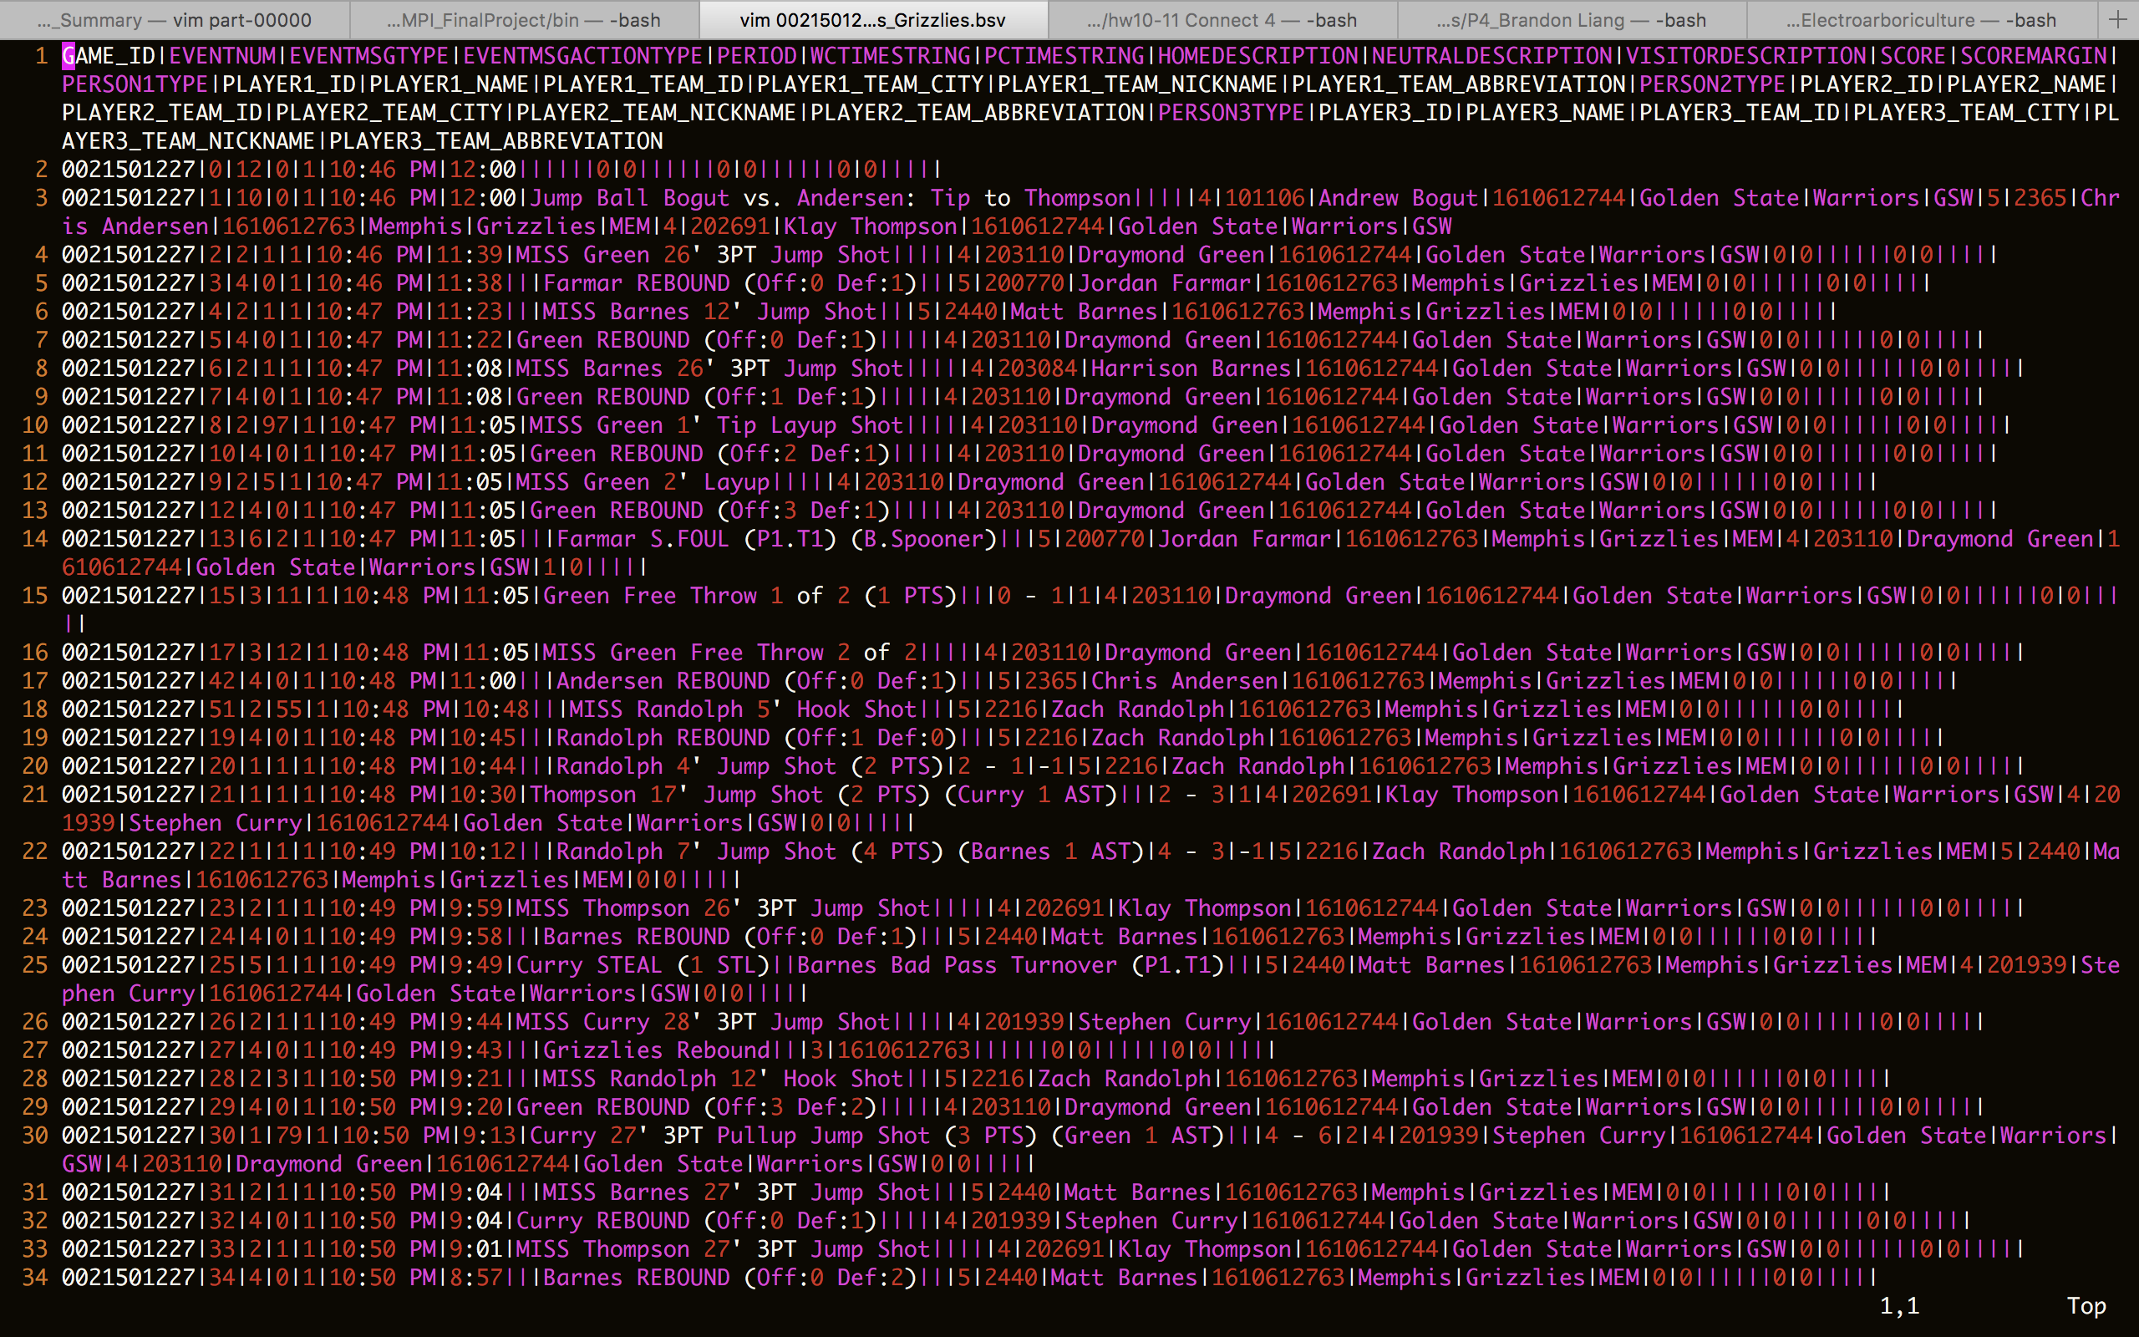

Slide 9
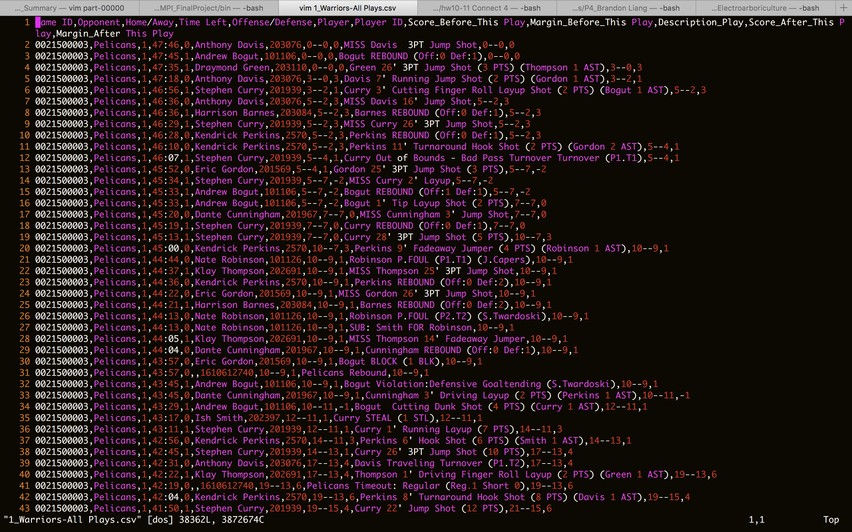

Slide 10
Aggregated Data
Margin Before | Margin After | Number of Occurrences
-30 | -30 | 3
-30 | -29 | 1
-30 | -27 | 1
-29 | -28 | 1
…... | ...... | …...
5 | 5 | 964
5 | 4 | 57
5 | 3 | 79
5 | 2 | 23

Slide 11
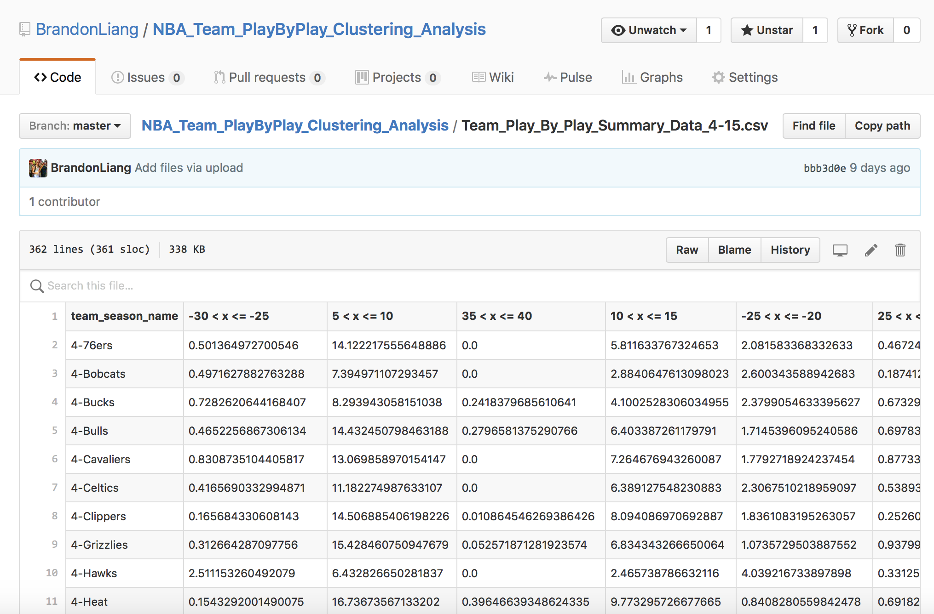
0

Slide 12
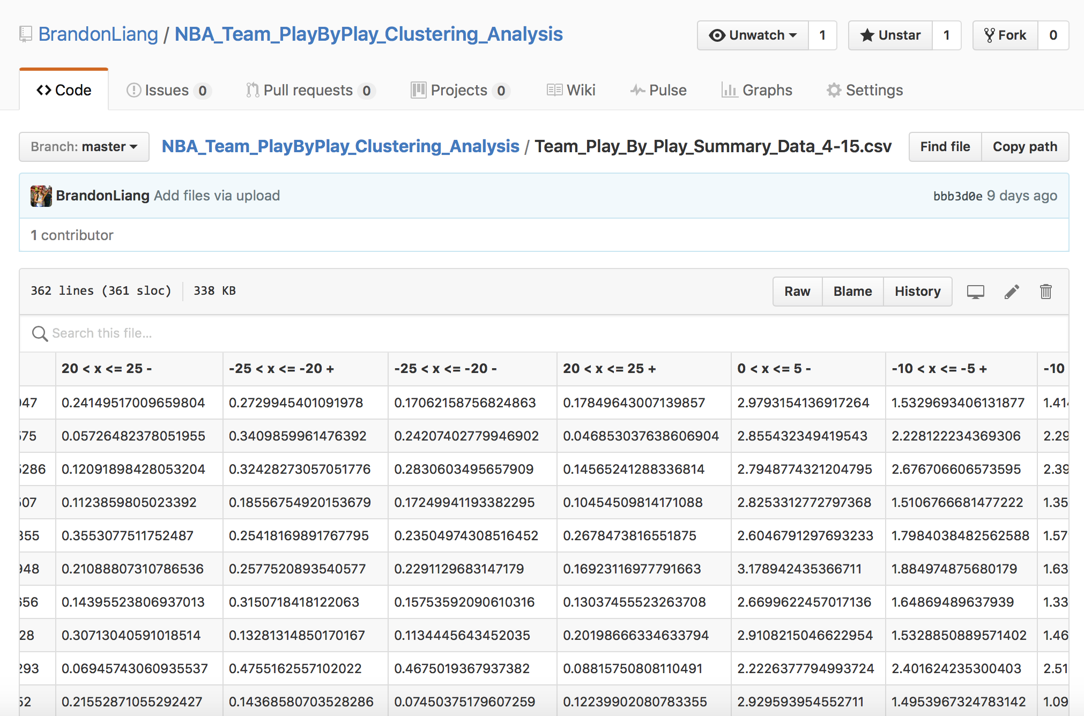

Slide 13
Final Dataset & Goal
Dataset:
360 Team-Season Pairs
56 Features (Dimension)
Unsupervised Clustering
# Clusters: K
# Iterations: N
Goal: Compare Runtime in MPI vs in Spark MLlib

Slide 14
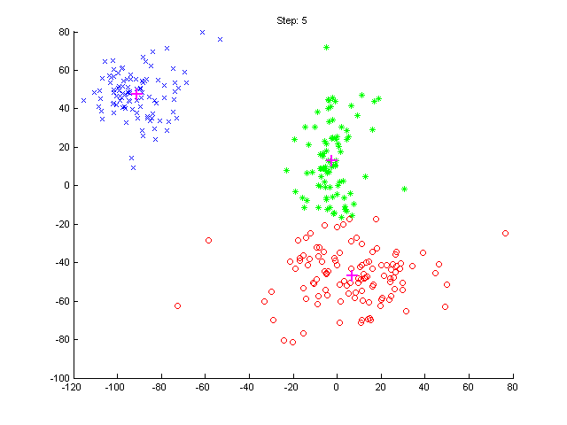
Clustering Algorithm
K-Means Clustering
Euclidean Distance
Unsupervised Learning

Slide 15
Implementation
KMeansClustering with MPI
n iterations;
m machines;
k clusters;
…
m

Slide 16
Implementation
From the entire dataset, we randomly picked k points to be the centers of clusters
k
…

Slide 17
Implementation
Broadcast the centers to all machines
For each iteration, in each machines, run KMeansClustering – Euclidean Distance with each center
Update each data point to the cluster with which it has the smallest distance
k
k
…
m

Slide 18
Implementation
From each machines to root machines, use allGather to collect points with respect to clusters and calculate the means to generate new centers;
…
…
…
…

Slide 19
Implementation
MPI
Implement from scratch (Why? Thinner layer)
Data parsing and arranging
Very much like Homework 4: Parallel Sorting
Spark
Thicker layer
MLlib - handy
Google Cloud Platform Virtual Machine – Clusters

Slide 20
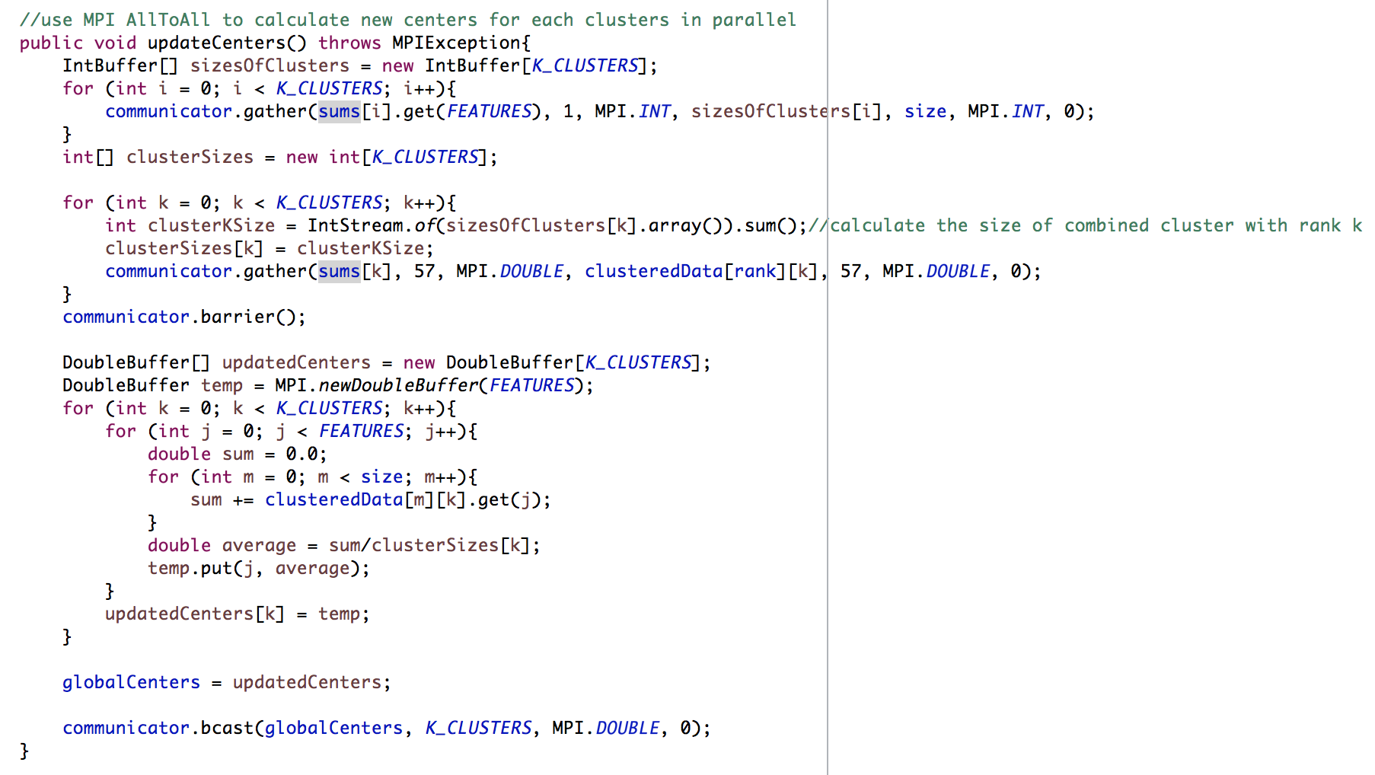
Code Snippet
MPI
local receiving buffer in root machine

Slide 21
Code Snippet
MPI
then broadcast to all machines

Slide 22
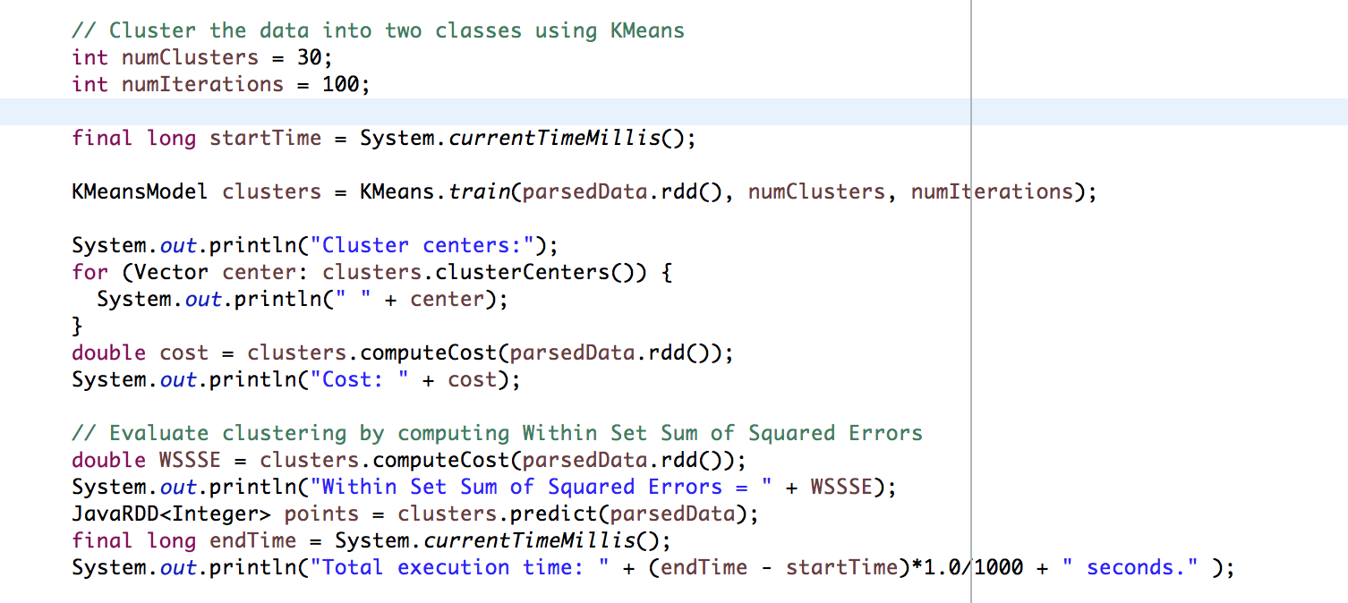
Code Snippet
Spark KMeansClustering
Spark MLlib

Slide 23
Hypothesis
Anticipate MPI to be faster
High performance oriented
Multi-core/multi-machine
Suitable for iterative computation

Slide 24
Current Results
30 Clusters
100 Iterations
Spark: 3.284 seconds
MPI – In Progress

Slide 25
Reference
http://www.sas.com/en_us/insights/analytics/machine-learning.html
http://www.sas.com/en_us/insights/big-data/what-is-big-data.html
http://stats.nba.com/stats/playbyplayv2?EndPeriod=10&EndRange=55800&GameID=0021600003&RangeType=2&Season=2015-16&SeasonType=Regular+Season&StartPeriod=1&StartRange=0

